Slide 1
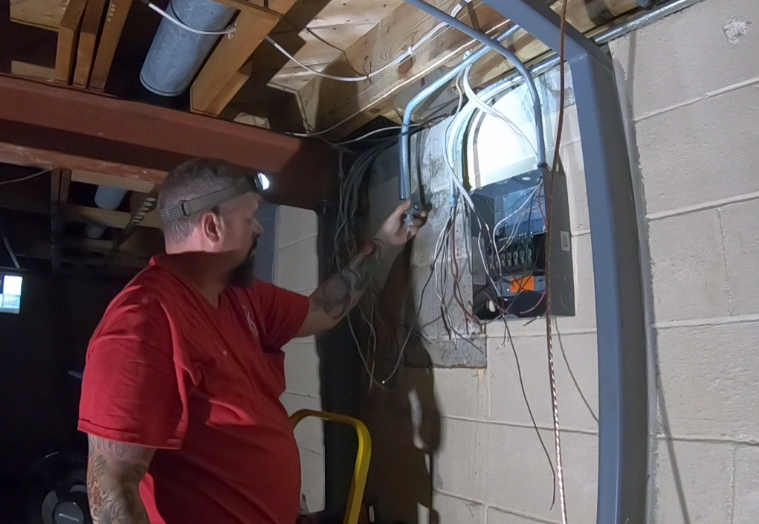
Application / task
Potential search queries: low light, head lamp, electrical, conduit, circuit box, basement, wire pulling

Slide 2
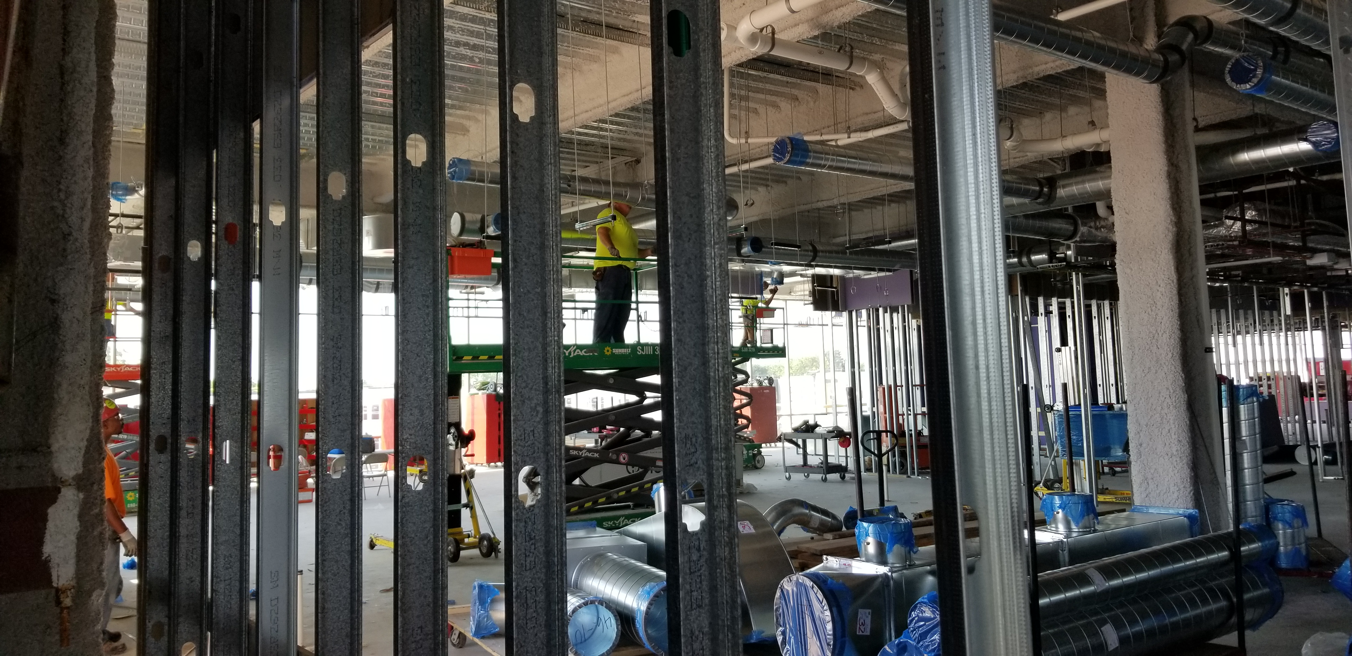
General Environment shot
Potential search queries: scissor lift, steel stud, HVAC, ductwork, threaded rod, Unistrut, spiral duct

Slide 3
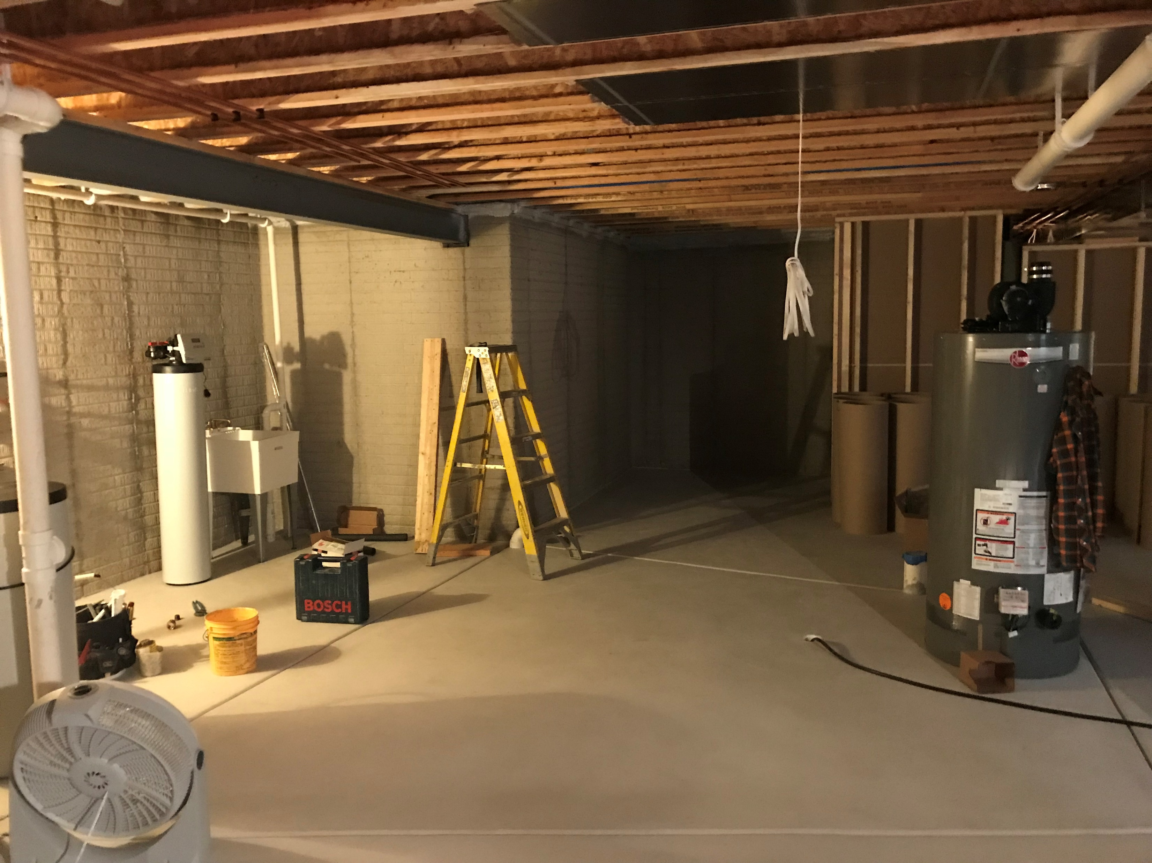
General Environment Shot
Potential search queries: basement, ladder, water heater, fan, 5 gallon bucket, utility sink, low light

Slide 4
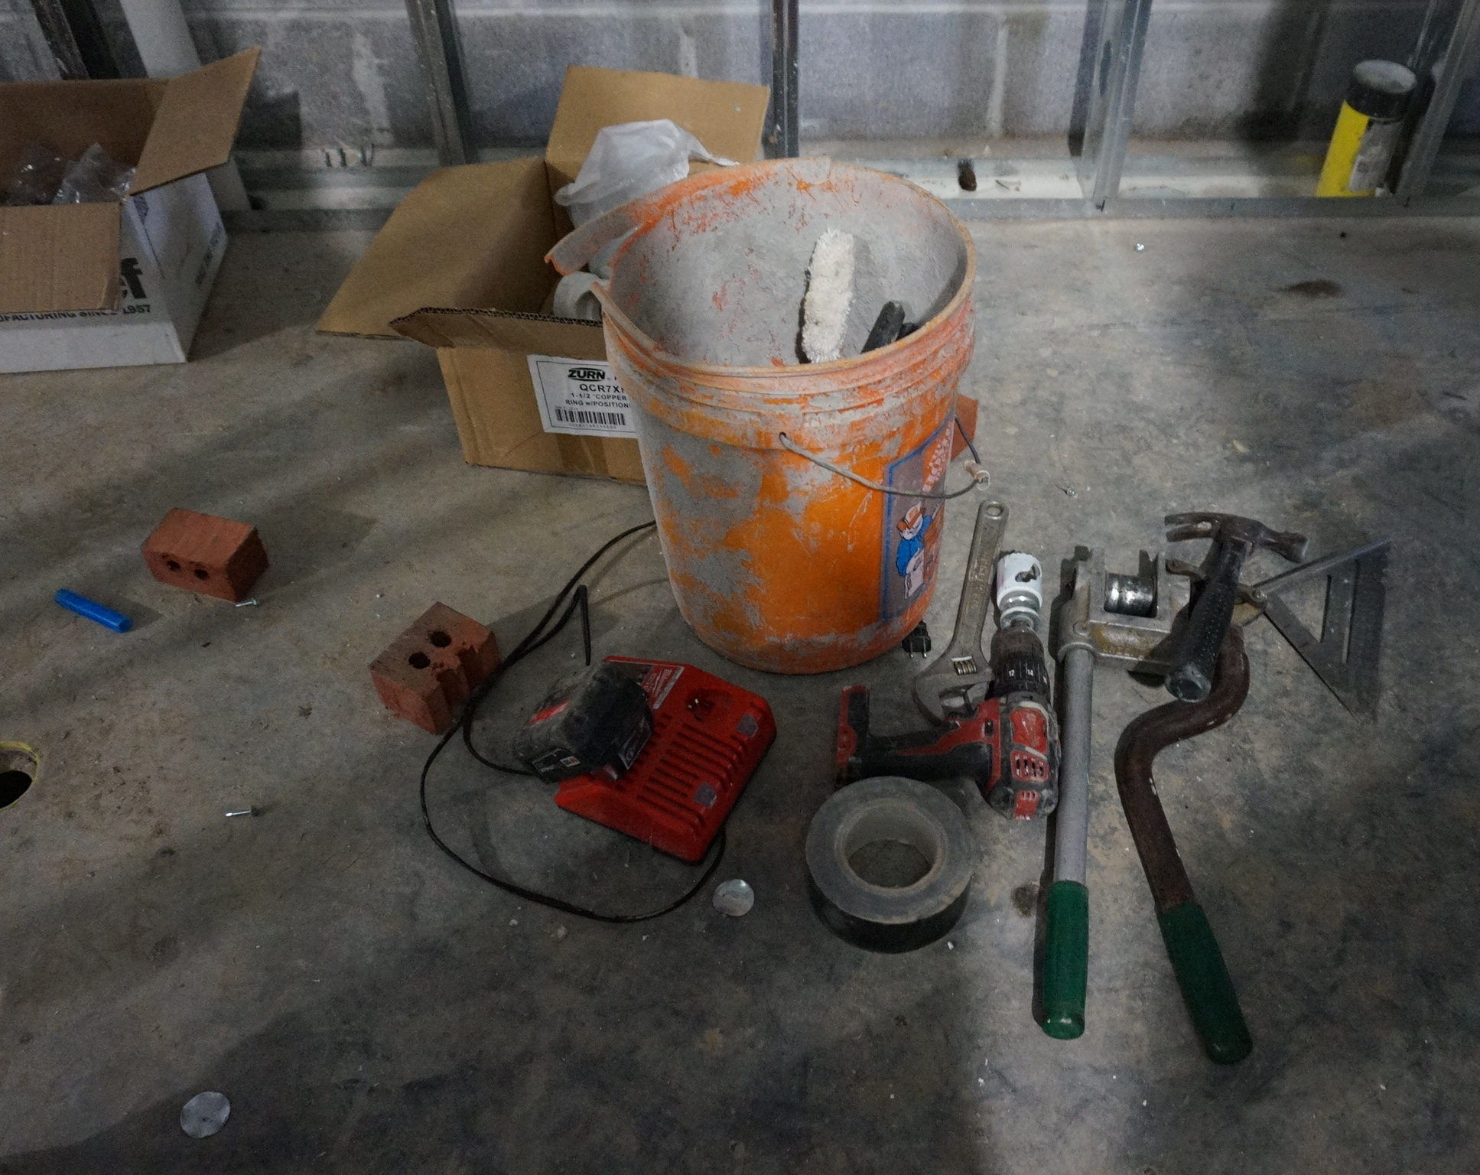
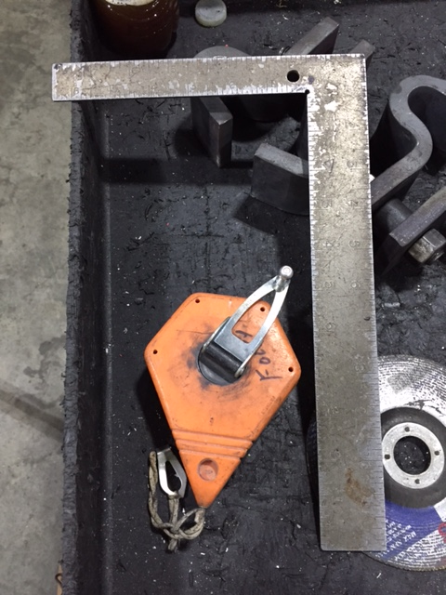
Tool Tour
Potential search queries: chalk line, square
Potential search queries: charger, duct tape, drill, wrench, hammer, carpenter’s square, hole saw, 5 gallon bucket

Slide 5
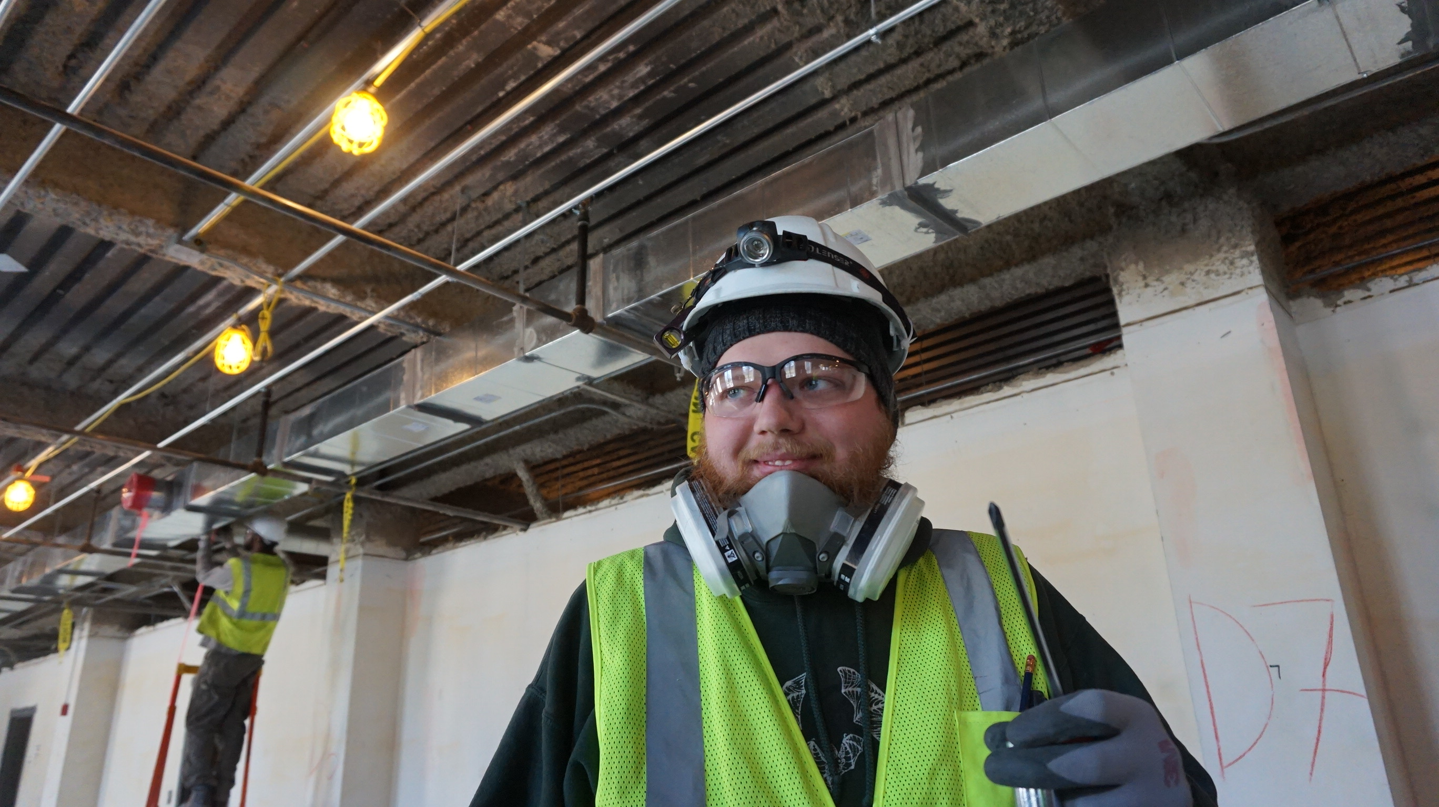
Tradesmen
Potential search queries: string lights, safety glasses, respirator, head lamp, beanie, hi-vis vest, gloves

Slide 6
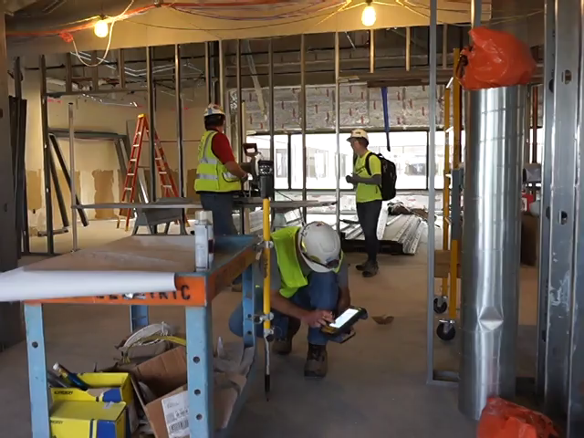
Video
Potential search queries: job cart, BIM, Trimble, total robotic station, layout, marking, hard hat, head lamp, pencil

